Slide 1
Stateless Contracts
…or ‘how to make off chain information actionable on chain.’

Slide 2
Agenda
Who Am I?
What are stateless contracts?
Why stateless contracts?
A stateless UTXO Token
Another stateless token
Stateless Code?
Stateless Calculations with zkSnarks

Slide 3
Who am I?
Austin Fatheree - @afat - @hypercatallax – Austin@catallax.info

Slide 4


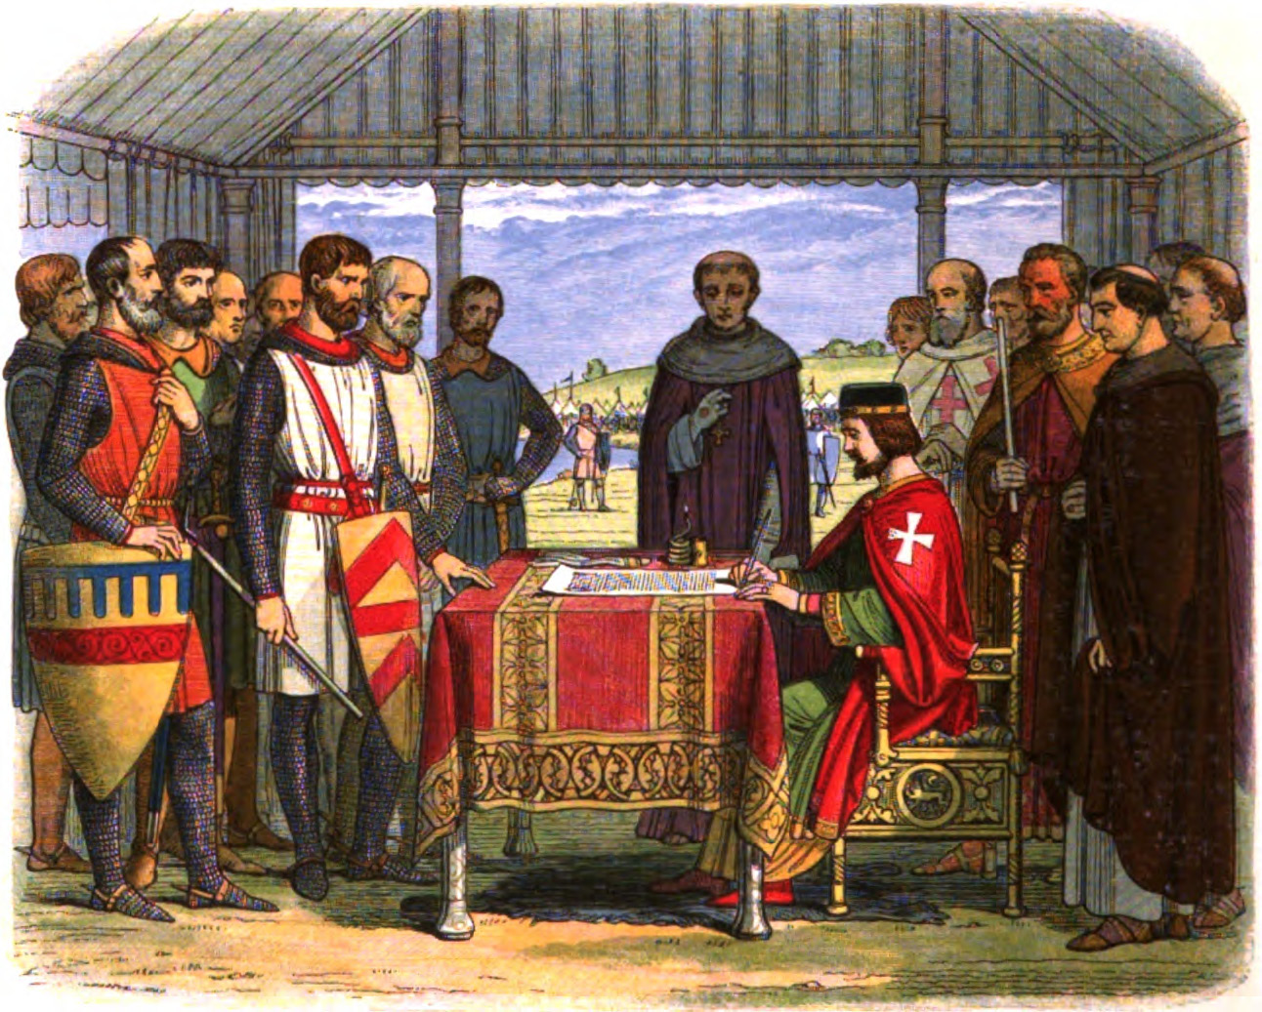



Catallax http://catallax.info

Slide 5


Immortality
Moral Philosophy
Economics
Government
Blockchain
https://amzn.to/2y0lkNy

Slide 6
Manhattan Beach – The South Bay
Funded with USD.
Pay salaries in USD.
Bonus Program, ESOP, Health Benefits
Hiring 30+ Engineers in the next 1-2 years
Austin@catallax.info

Slide 7
What are stateless contracts?

Slide 8
Different way to be stateless
+
Stateless Data
Stateless Code
Both!
Some or all data lives outside of the contract
Some or all of the code lives outside the contract
Madness!

Slide 9
Today’s Focus
+
Stateless Data
Stateless Code
Both!
Some or all data lives outside of the contract
Some or all of the code lives outside the contract
Madness!

Slide 10
Why Stateless Data?
How do you put the Rose Bowl on the Blockchain?
100,000 Seats
12 B
gas
$27,000
game
5.5hours
of 100% of the Ethereum Chain
Stateless Data
How does Amazon Sell its Inventory on the Blockchain?
Some or all data lives outside of the contract
562M Products
23 T
gas
$1.2B
load
29 years
of 100% of the Ethereum Chain

Slide 11
A stateless UTXO

Slide 12
UTXO TRANSACTIONS
UNSPENT TRANSACTION OUTPUTS – Using Merkle Trees
Root
Root
Root
Hash(L,R)
Hash(L,R)
Hash(0xA, 1,000,000)
Hash(L,R)
Hash(0xB, 5)
Hash(0xA, 999,995)
Hash(0xB, 5)
Hash(0xA, 999,900)
Hash(0xC, 15)

Slide 13
A GROWING TREE
Root
Hash(L,R)
Hash(L,R)
Hash(0xB, 5)
Hash(0xA, 999,900)
Hash(0xG, 999,900)
Hash(0xH, 15)
Hash(L,R)
Hash(0xG, 999,900)
Hash(0xH, 15)
Hash(0xD, 999,900)
Hash(L,R)
Hash(0xG, 999,900)
Hash(0xH, 15)
Hash(L,R)
Hash(0xF, 15)
Hash(0xG, 999,900)
Hash(0xH, 15)
Hash(0xE, 999,900)
Hash(L,R)
Hash(0xG, 999,900)
Hash(0xH, 15)
Hash(0xG, 999,900)
Hash(0xH, 15)
Hash(0xG, 999,900)
Hash(0xH, 15)
Hash(0xG, 999,900)
Hash(0xH, 15)

Slide 14
BUILDING A “WITNESS”
Root
Hash(L,R)
ADDRESS
Hash(L,R)
Hash(0xB, 5)
BALANCE
Hash(0xA, 999,900)
Hash(L,R)
LEFT
RIGHT
Hash(0xD, 999,900)
Hash(L,R)
LEFT
Hash(L,R)
Hash(0xF, 15)
RIGHT
…
Hash(0xE, 999,900)
Hash(L,R)
LEFT
RIGHT
Hash(0xG, 999,900)
Hash(0xH, 15)
ROOT

Slide 15
CODE!
bytes32 public root; //HOLDS OUR ROOT
constructor() public {
owner = msg.sender;
totalSupply = 1000000 * 10**18;
root = keccak256(
abi.encodePacked(
bytes32(msg.sender),
bytes32(totalSupply)
));
emit NewBranch(0x0, 0x0, bytes32(msg.sender), bytes32(totalSupply), 0x0);
}

Slide 16
CODE!
function Transfer(address _to, uint256 _amount, bytes32[] proof) public {
require(verifyProof(bytes32(msg.sender), proof[1], proof, root));
require(_amount < uint256(proof[1]));
root = splitBalance(bytes32(msg.sender), bytes32(uint256(proof[1]) - _amount), bytes32(_to), bytes32(_amount), proof);
}

Slide 17
CODE!
function Transfer(address _to, uint256 _amount, bytes32[] proof) public {
require(verifyProof(bytes32(msg.sender), proof[1], proof, root));
require(_amount < uint256(proof[1]));
root = splitBalance(bytes32(msg.sender), bytes32(uint256(proof[1]) - _amount), bytes32(_to), bytes32(_amount), proof);
}

Slide 18
CODE!
function splitBalance(bytes32 _sender, bytes32 _senderBalance, bytes32 _to, bytes32 _toBalance, bytes32[] proof) private returns(bytes32){
bytes32 lastHash;
bytes32 newLeaf;
require(_toBalance > 0);
newLeaf = keccak256(
abi.encodePacked(
keccak256(abi.encodePacked(_sender, _senderBalance)),
keccak256(abi.encodePacked(_to,_toBalance))));
bytes32 newHash = newLeaf;
for(uint thisProof = 0; thisProof < proof.length; thisProof++){
if(thisProof == 0){
//do nothing, this is what we are replacing
} else if(thisProof == 1){
lastHash = keccak256(abi.encodePacked(proof[0], proof[1]));
if(lastHash == proof[2]){
emit NewBranch(_sender, _senderBalance, _to,_toBalance, proof[2]);
} else {
emit NewBranch(_sender, _senderBalance, _to,_toBalance, proof[3]);
}
emit SwapLeaf(lastHash, newLeaf);
} else if(thisProof == proof.length -1){
//do nothing we have newHash
}
else{
if(proof[thisProof] == lastHash){
lastHash = keccak256(abi.encodePacked(lastHash, proof[thisProof + 1]));
newHash = keccak256(abi.encodePacked(newHash, proof[thisProof + 1]));
emit SwapLeaf(lastHash, newHash);
//todo: check and swap equivalence in block
thisProof++;
} else {
lastHash = keccak256(abi.encodePacked(proof[thisProof], lastHash));
newHash = keccak256(abi.encodePacked(proof[thisProof], newHash));
emit SwapLeaf(lastHash, newHash);
//todo: check and swap equivalence in block
thisProof++;
}
}
}
return newHash;
}

Slide 19
CODE!
function splitBalance(bytes32 _sender, bytes32 _senderBalance, bytes32 _to, bytes32 _toBalance, bytes32[] proof) private returns(bytes32){
bytes32 lastHash;
bytes32 newLeaf;
require(_toBalance > 0);
newLeaf = keccak256(
abi.encodePacked(
keccak256(abi.encodePacked(_sender, _senderBalance)),
keccak256(abi.encodePacked(_to,_toBalance))));
bytes32 newHash = newLeaf;
for(uint thisProof = 0; thisProof < proof.length; thisProof++){
if(thisProof == 0){
//do nothing, this is what we are replacing
} else if(thisProof == 1){
lastHash = keccak256(abi.encodePacked(proof[0], proof[1]));
if(lastHash == proof[2]){
emit NewBranch(_sender, _senderBalance, _to,_toBalance, proof[2]);
} else {
emit NewBranch(_sender, _senderBalance, _to,_toBalance, proof[3]);
}
emit SwapLeaf(lastHash, newLeaf);
} else if(thisProof == proof.length -1){
//do nothing we have newHash
}
else{
if(proof[thisProof] == lastHash){
lastHash = keccak256(abi.encodePacked(lastHash, proof[thisProof + 1]));
newHash = keccak256(abi.encodePacked(newHash, proof[thisProof + 1]));
emit SwapLeaf(lastHash, newHash);
//todo: check and swap equivalence in block
thisProof++;
} else {
lastHash = keccak256(abi.encodePacked(proof[thisProof], lastHash));
newHash = keccak256(abi.encodePacked(proof[thisProof], newHash));
emit SwapLeaf(lastHash, newHash);
//todo: check and swap equivalence in block
thisProof++;
}
}
}
return newHash;
}
Calculate a new Leaf
Loop Through the Proof
Announce Changes to Leaves
Recalc if we know the left branch
Recalc if we know the right branch

Slide 20
CODE!
function verifyProof(bytes32 dataPath, bytes32 dataBytes, bytes32[] proof, bytes32 _root) pure public returns(bool){
bytes32 lastHash;
for(uint thisProof = 0; thisProof < proof.length; thisProof++){
if(thisProof == 0){
require(dataPath == proof[thisProof] );
} else if(thisProof == 1){
require(dataBytes == proof[thisProof]);
lastHash = keccak256(abi.encodePacked(dataPath, dataBytes));
} else if(thisProof == proof.length - 1){
require(lastHash == proof[thisProof]);
} else{
if(proof[thisProof] == lastHash){
lastHash = keccak256(abi.encodePacked(lastHash, proof[thisProof + 1]));
thisProof++;
} else {
require(proof[thisProof + 1] == lastHash);
lastHash = keccak256(abi.encodePacked(proof[thisProof], lastHash));
thisProof++;
}
}
}
require(lastHash == _root);
return true;
}

Slide 21
Test!
it "can create known root ", ->
instance = await StatelessToken.new(from: owner)
tree = new Tree.Tree()
tree.addItem(
web3Utils.padLeft(owner,64),
web3Utils.padLeft(
web3Utils.numberToHex(
web3Utils.toWei("1000000","ether")),64
)
)
tree.buildTree()
root = await instance.root.call()
assert.equal(root, tree.root)

Slide 22
Test!
it "can verify initial balance", ->
instance = await StatelessToken.new(from: owner)
tree = new Tree.Tree()
tree.addItem(
web3Utils.padLeft(owner,64), web3Utils.padLeft(
web3Utils.numberToHex(
web3Utils.toWei("1000000","ether")),64
)
) tree.buildTree()
proof = tree.getProof(web3Utils.padLeft(owner,64))
result = await instance.verifyProof.call(web3Utils.padLeft(owner,64), web3Utils.padLeft(
web3Utils.numberToHex(
web3Utils.toWei("1000000","ether")),64),
[].concat(...proof),
tree.root)
assert.equal(result, true)

Slide 23
Test!
it "can transfer tokens",
instance = await StatelessToken.new(from: owner)
tree = new Tree.Tree()
tree.addItem(
web3Utils.padLeft(owner,64), web3Utils.padLeft(
web3Utils.numberToHex(
web3Utils.toWei("1000000","ether")),64 ))
tree.buildTree()
proof = tree.getProof(web3Utils.padLeft(owner,64))
expectedRoot = “” //calculate the expected Root
trx = await instance.Transfer(
reciever
web3Utils.toWei("100","ether")
[].concat(...proof)
{from: owner}
) for i in trx.logs
newLeafHash = “” #find new leaf has
newRoot = ”” #find new root assert.equal(expectedRoot, newRoot)

Slide 24
Problems with this model
Proofs can get really long
Only 1 transaction on the contract per block
Clean up is difficult – lots of dust and separated balances
Not ERC20 Compliant
Everyone needs to keep up with their own witnesses.

Slide 25
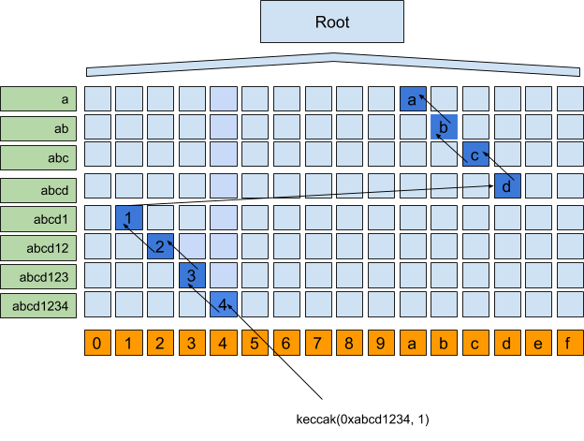
Solution – Patricia Trees Lets Clean up the dust problem

Slide 26
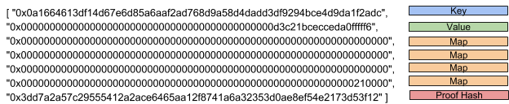
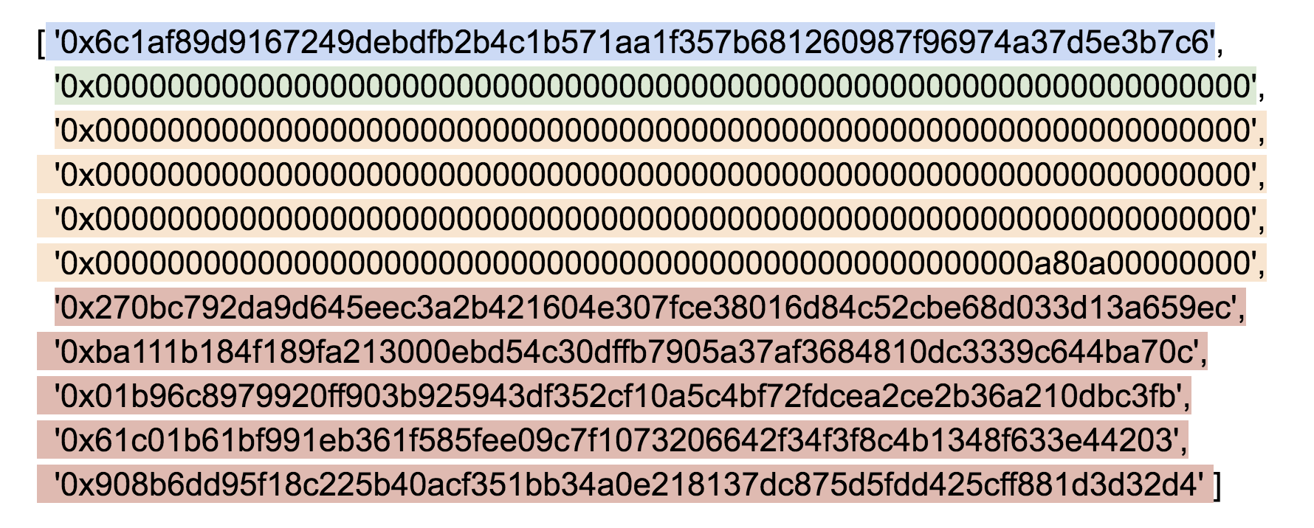
Patricia Proofs

Slide 27
Our new transfer function
function superTransfer(
address destination,
uint256 amount,
bytes32[] memory destinationProof,
bytes32[] memory senderProof) public returns(bytes32)
ROOT
0x000…000
0xFFF…FFF
Patricia Space
0xafd…9f8
0xafd…324

Slide 28

Hmmmm……

Slide 29
Lessons Learned
We need some kind of short term storage op code that uses less gas than full storage.
https://ethresear.ch/t/block-persistent-storage/817/7
It would be nice to have a much cheaper 0x46 BLOAD and 0x47 BSTORE that could store this mapping during the processing of the block so that my contract can swap out hashes for any additional transactions included in the block.
Native RLP decoding / hashing at a reasonable gas cost would be helpful.
Assembly can help reduce the gas costs.
Sparse trees are cheaper.
It isn’t realistic to do tree updating in solidity without a precompile.

Slide 30
Stateless Code
+
Stateless Data
Stateless Code
Both!
Some or all data lives outside of the contract
Some or all of the code lives outside the contract
Madness!

Slide 31
Catallax – Decaying Currency – A gas problem
Payment
T=2
3rd Party
Payment
Payment
T=1
T=3
Me
Payment
3rd Party
T=4
You
3rd Party

Slide 32
Move forward in time
Catallax – Decaying Currency – A gas problem
Payment
T=2
3rd Party
Payment
Payment
T=1
T=3
Me
Payment
3rd Party
T=4
You
3rd Party

Slide 33
Decay transactions increase with each account
that you have received funds from.
Decay
Decay
Payment
T=6
Decay
3rd Party

Slide 34
…which becomes a problem if you are Amazon.
Decay
Decay
Decay
Decay
Decay
Decay
Decay
Decay
Decay
Decay
Decay
Decay
Decay
Decay
Decay
Decay
Decay
Decay
Decay
Decay
Decay
Decay
Decay
Decay
Decay
Decay
Decay
Decay
Decay
Decay
Decay
Decay
Decay
Decay
Decay
Decay
Decay
Decay
Decay
Decay
Decay
Decay
Decay
Decay
Decay
Decay
Decay
Decay
Decay
Decay
Decay
Decay
Decay
Decay
Decay
Decay
Decay
Decay
Decay
Decay
Decay
Decay
Decay
Decay
Decay
Decay
Decay
Decay
Decay
Decay
Decay
Decay
Decay
Decay
Decay
Decay
Decay
Decay
Decay
Decay
Payment
Decay
Decay
Decay
Decay
Decay
Decay
Decay
Decay
Decay
Decay
Decay
Decay
Decay
Decay
Decay
Decay
Decay
Decay
Decay
Decay
Decay
Decay
Decay
Decay
Decay
Decay
Decay
Decay
Decay
Decay
Decay
Decay
Decay
Decay
Decay
Decay
Decay
Decay
Decay
T=6
Decay
Decay
Decay
Decay
Decay
Decay
Decay
Decay
Decay
Decay
Decay
Decay
Decay
Decay
Decay
Decay
Decay
Decay
Decay
Decay
Decay
Decay
Decay
Decay
Decay
Decay
Decay
Decay
Decay
Decay
Decay
Decay
Decay
Decay
Decay
Decay
Decay
Decay
Decay
Decay
Decay
Decay
Decay
Decay
Decay
Decay
Decay
Decay
Decay
Decay
Decay
Decay
Decay
Decay
Decay
Decay
Decay
Decay
Decay
Decay
Decay
Decay
Decay
Decay
Decay
Decay
Decay
Decay
Decay
Decay
Decay
Decay
Decay
Decay
Decay
Decay
Decay
Decay
Decay
Decay
Decay
Decay
Decay
Decay
Decay
Decay
Decay
Decay
Decay
Decay
Decay
Decay
Decay
Decay
Decay
Decay
Decay

Slide 35
So instead we dump decay into a pool and ask you to make a claim when claim > gas cost.
Claim
Decay
Payment
T=6
Pool

Slide 36
The calculation is is easy:
Here are the transactions where I had a share of decay
Validate Each one
If valid, here is the percentage of that decay that was mine
Validate Amount
Sum them all together
The amount I can take from the decay pool: $X
….But the limit on gas makes it very difficult to do on-chain because the upper bound on the number of loops can be very high.

Slide 37
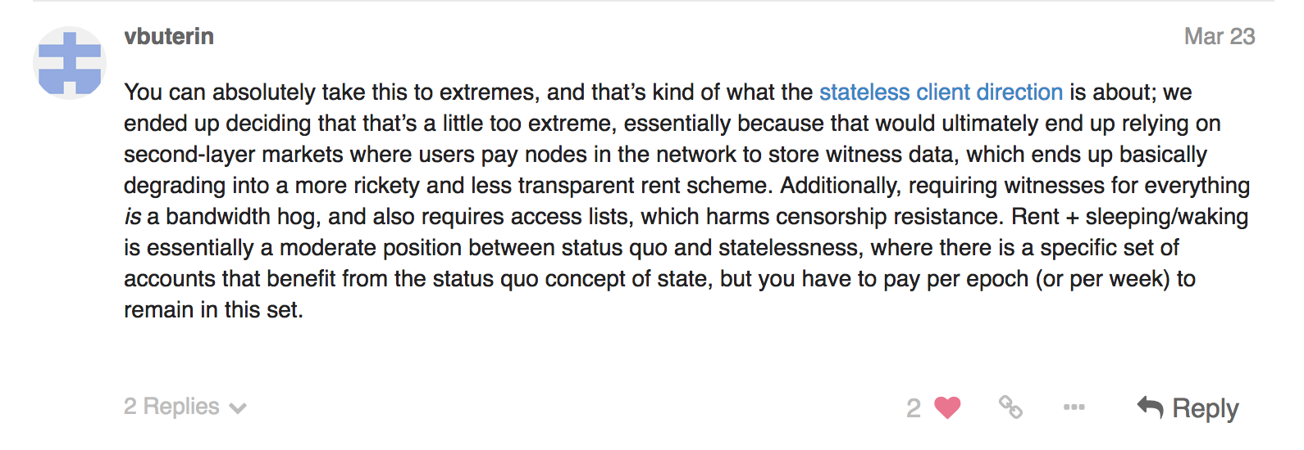
If we have simple code…
And we can take a hash of that code…
And only put the hash of the code on the chain...
And if we required the code as part of the witness…
Why is our contract code going on the chain?
https://ethresear.ch/t/improving-the-ux-of-rent-with-a-sleeping-waking-mechanism/1480/3

Slide 38
Therefore:
The Ethereum project can’t risk rickety code.
As an independent developer, you can build all the rickety code you want…and the harden it. Build something awesome.

Slide 39
Stateless Data + Code
+
Stateless Data
Stateless Code
Both!
Some or all data lives outside of the contract
Some or all of the code lives outside the contract
Madness!

Slide 40
Move the data verification into a zkSnark
Witness 1
zkProof
Witness 2
New Root
Blockchain
zkSnark
Transaction

Slide 41
Data is in witnesses.
Transaction is Small and only one variable must be updated.
Data must follow rules here.
Witness 1
zkProof
Witness 2
New Root
Blockchain
zkSnark
Transaction

Slide 42
Demo Projects
Miximus
When someone sends 1 ether to the deposit function in miximus.sol they append single leaf to the merkle tree.
Afterwards someone who has the secret key (sk) and nullifier of the leaf of the merkle tree is allowed to withdraw 1 ether. But instead of revealing the information to prove that they control it. They (using a zksnark) produce a proof that they know this information without revealing it. They also create a proof that their leaf is in the merkle tree.
When they verify this proof they reveal the nullifier, but not the sk. So no one is able to tell which nullifier maps to which leaf.
To prevent double spends the smart contract tracks the nullifiers and only allows a single withdrawal per nullifiers.
https://github.com/barryWhiteHat/miximus
Coda
Coda uses recursive composition of zk-SNARKs to compress the whole blockchain down to the size of a few tweets.
No one needs to store or download transaction history in order to verify the blockchain.
https://codaprotocol.com/

Slide 43
Demo Projects
Roll_up / roll_back snark side chain ~17000 tps
https://ethresear.ch/t/roll-up-roll-back-snark-side-chain-17000-tps/3675
A snark based side chain is introduced. It requires constant gas per state transition independent of the number of transactions included in each transition. This limits scalability at the size of snark that can be economically proven, rather than the gasBlockLimit/gasPerTx as proposed previous.
Zokrates
https://github.com/JacobEberhardt/ZoKrates
Ethereum runs computations on all nodes of the network, resulting in high costs, limits in complexity, and low privacy. SNARKs have been enabling to only verify computations on-chain for a fraction of the cost of running them, but are hard to grasp and work with.
Zokrates bridges this gap. It helps you create offchain programs and link them to the Ethereum blockchain, expanding the possibilities for your Dapp.
ZoKrates tutorial with Truffle
https://medium.com/extropy-io/zokrates-tutorial-with-truffle-41135a3fb754

Slide 44
Thank You!
https://github.com/skilesare/StatelessTokens
Austin Fatheree - @afat - @hypercatallax – Austin@catallax.info

